Slide 1
ARTIFICIAL INTELLIGENCE&MACHINE LEARNING COURSE PROJECT Title: IRIS FLOWER PREDICTION

Slide 2
TEAM MEMBERS:
2103A51481 N Chandana Azith
2103A51280 K Chaitanya Jyothi

Slide 3
Problem Statement:
Classification of iris flowers based on their physical characteristics like sepal length, sepal width, petal length & petal width.

Slide 4
The problem statement for iris flower prediction is to develop a machine learning model that can accurately classify iris flowers into their respective species based on their sepal length, sepal width, petal length, and petal width measurements.
The goal is to create a model that can learn from a given dataset of iris flowers and predict the species of an unknown iris flower with high accuracy. This problem is commonly known as the iris classification problem and is a popular benchmark problem in the field of machine learning.
The dataset used for this problem contains measurements of 150 iris flowers, with 50 samples from each of the three species (Iris setosa, Iris versicolor, and Iris virginica). The dataset is split into a training set and a testing set, and the model is evaluated based on its accuracy on the testing set.

Slide 5
PROPOSED APPROACH
To predict the type of iris flower based on its characteristics, you can follow the following approach:
Data Collection: Collect the data on iris flowers including the features such as sepal length, sepal width, petal length, petal width, and their corresponding labels (i.e., the type of iris flower).
Data Preprocessing: Preprocess the data by removing any missing or irrelevant values, handling outliers, and scaling the features if required.
Data Splitting: Split the data into training and testing sets. The training set will be used to train the model, and the testing set will be used to evaluate the model's performance.
Model Selection: Choose a suitable machine learning model that can predict the type of iris flower based on the input features. Some popular models for this task include logistic regression, decision tree, random forest, and support vector machines.

Slide 6
Model Training: Train the selected model on the training data using appropriate training algorithms and hyperparameters. You can also perform cross-validation to tune the model's hyperparameters and improve its performance.
Model Evaluation: Evaluate the model's performance on the testing data by calculating metrics such as accuracy, precision, recall, F1 score, and confusion matrix.
Model Deployment: Deploy the trained model in a production environment where it can predict the type of iris flower based on new input features.
Overall, the approach involves collecting and preprocessing data, selecting and training a suitable machine learning model, evaluating its performance, and deploying it in a production environment.

Slide 7
DATASET Attributes: In this data set : There are 5 attributes 150 rows Train test split 70% training , 30% testing
Method used:
We have used Logistic regression, KNN, Decision tree and Support vector machine(SVM) for this dataset.

Slide 8
IMPLEMENTATION SAMPLE
Model used is Logistic Regression.
Logistic regression is one of the most popular Machine Learning algorithms, which comes under the Supervised Learning technique.
It is used for predicting the categorical dependent variable using a given set of independent variables.
Logistic regression predicts the output of a categorical dependent variable.
Therefore the outcome must be a categorical or discrete value.
It can be either Yes or No, 0 or 1, true or False, etc. but instead of giving the exact value as 0 and 1, it gives the probabilistic values which
lie between 0 and 1.
Logistic Regression is much similar to the Linear Regression except that how they are used.
Linear Regression is used for solving Regression problems, whereas Logistic regression is used for solving the classification problems.
In Logistic regression, instead of fitting a regression line, we fit an "S" shaped logistic function, which predicts two maximum values (0 or 1).

Slide 9
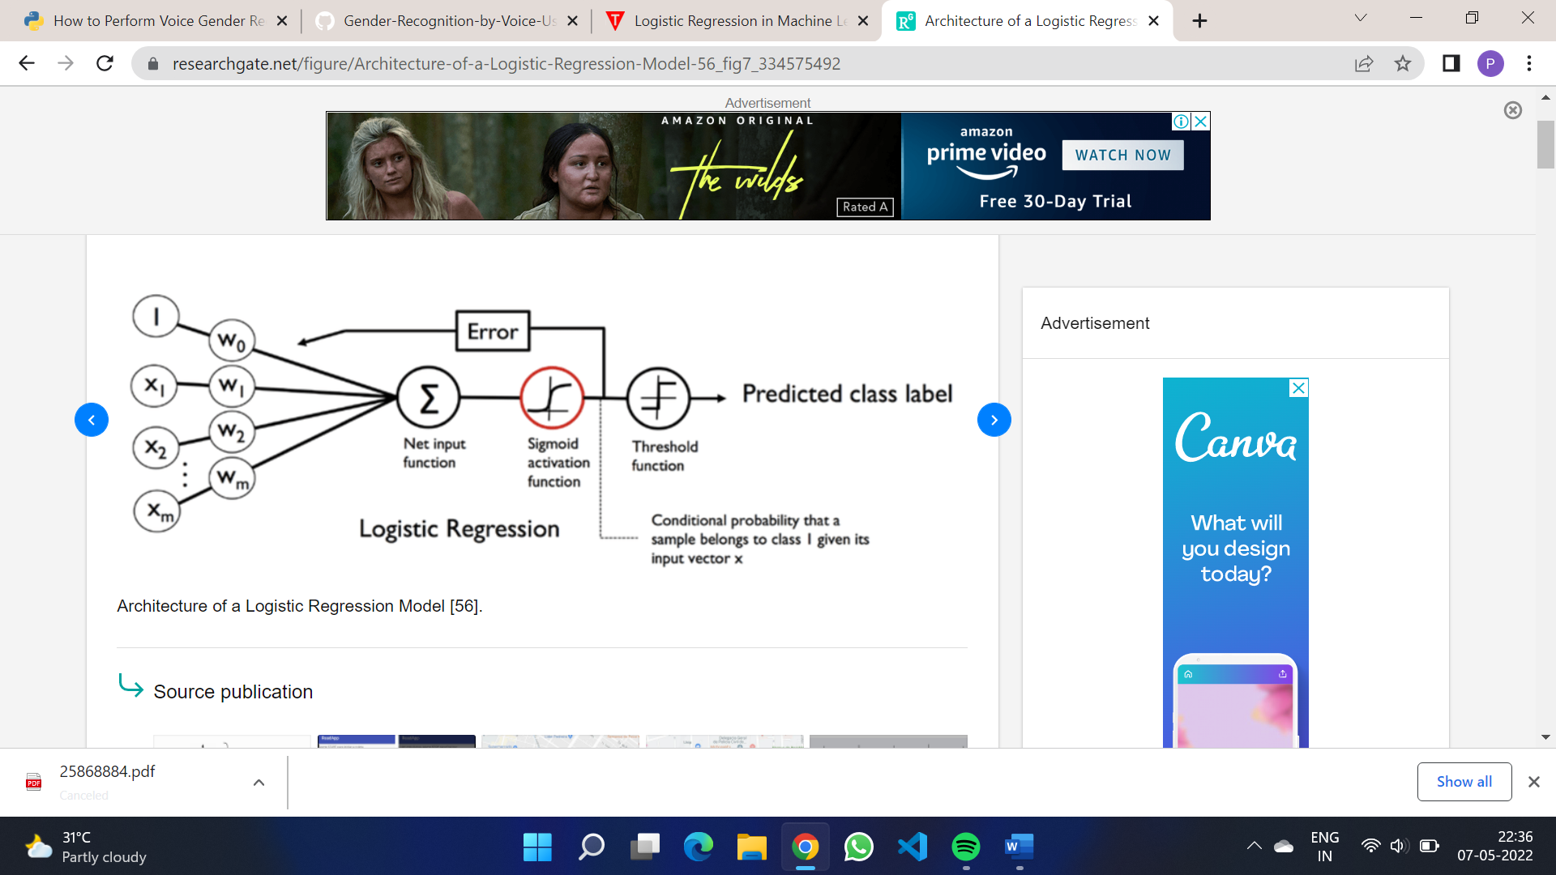
Architecture of logistic regression

Slide 10
ALGORITHMS
Several algorithms can be used for iris flower prediction. Here are some commonly used algorithms:
K-Nearest Neighbors (KNN): KNN is a simple algorithm that classifies a new observation based on the class of its K-nearest neighbors in the training dataset. In the case of iris flower prediction, KNN can be used to find the K-nearest neighbors based on the four features of the flower.
Decision Tree: Decision trees are used for both regression and classification tasks. It works by creating a tree-like model of decisions and their possible consequences. For iris flower prediction, the decision tree can be used to classify the species of the flower based on the four features.
Support Vector Machine (SVM): SVM is a supervised machine learning algorithm used for classification and regression tasks. It works by finding the optimal hyperplane that separates the different classes. In the case of iris flower prediction, SVM can be used to find the optimal hyperplane that separates the three species of flowers based on the four features.

Slide 11
CONCLUSION
For the dataset we have used Support Vector machine for Iris flower prediction. Support vector machine gives accuracy of 0.933%.

Slide 12
THANK YOU

